Slide 1

Solid Architecture Design
How to plan a good project, code effectively and build an application that is easy to work with which scales efficiently
AKA – Work smart; Prevent headaches

Slide 2
Who Am I?
Avid Traveler
V School Graduate (December 2018)
Full Time Lead Back EnD Developer
Specialize in API Integrations + software design

Slide 3
What is S.O.L.I.D.?
An acronym
A set of software design principles
A set of industry standards
Developed for Object Oriented Programming
Equally applicable to Functional & Imperative Programming

Slide 4
*Disclaimer
NOT how to write code
IS how to think about writing code

Slide 5
Why Use S.O.L.I.D.?
Easier to plan and scope projects
Structures code in a logical manner
Promotes Reusability (DRY)
Easily ‘drag and drop’ components, logic & functions
Much faster debugging
New code rarely breaks what already works

Slide 6
S.O.L.I.D.
S - Single Responsibility Principle
O - Open-Closed Principle
L - Liskov Substitution Principle
I - Interface Segregation Principle
D - Dependency Inversion Principle

Slide 7
S = Single Responsibility Principle
A Class [Function/Component] should have one responsibility
Only do one thing, do that thing well
Referential Transparency
Why?
Let’s us swap out / replace updated functionality
Isolate Bugs faster
Ask:
Does this do only one thing and does it do that thing well?

Slide 8
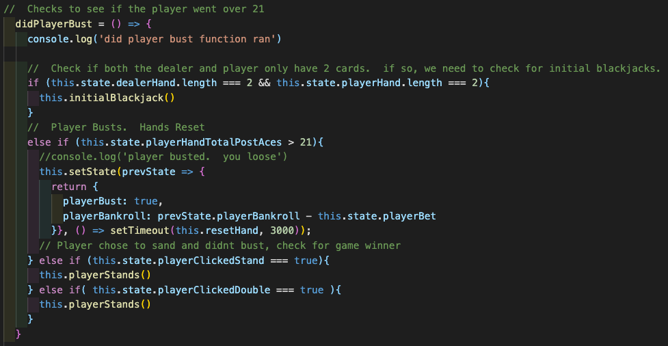
Single Responsibility - Bad Example

Slide 9
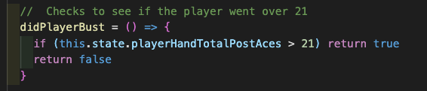
Single Responsibility - Good Example

Slide 10
O = Open / Closed Principle
A Class [Function/Component] should be open for extension but closed for modification
Write your code so that you will be able to add new functionality without changing the existing code.
Why?
Prevents situations where a change to something also requires you to adapt something existing
Reduces ‘Spaghetti Code’
Scale new features faster
Ask:
Can I make this behave differently and do new things without
changing my code?

Slide 11
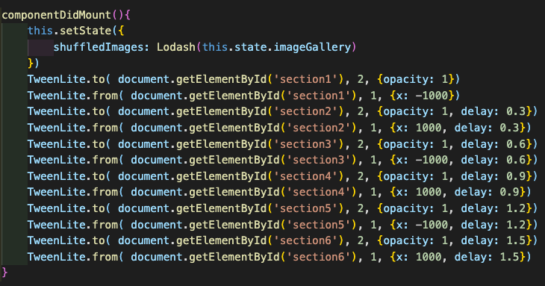
Open / Closed - Bad Example

Slide 12
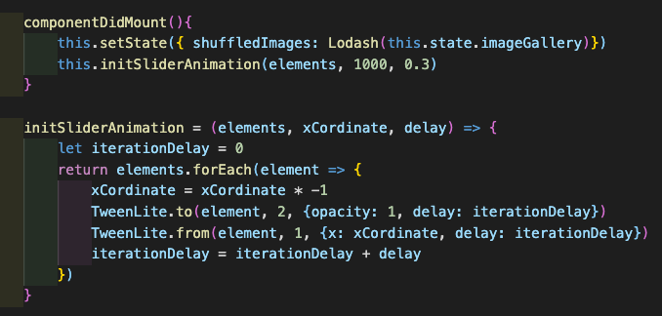
Open / Closed - Good Example

Slide 13
L = Liskov Substitution Principle ***
A Class [Function/Component] should be replaceable with instances of their subtypes without altering the correctness of the program
Code should be able to overwrite itself without breaking logic
Covariance
Barbara Liskov
Why?
Keeps programs behaving in a predictable way
Consistent input parameters requiring less validation
Improves inheritance
Ask:
Does this inherit data from somewhere else and will it behave the
same way if my data types change?

Slide 14
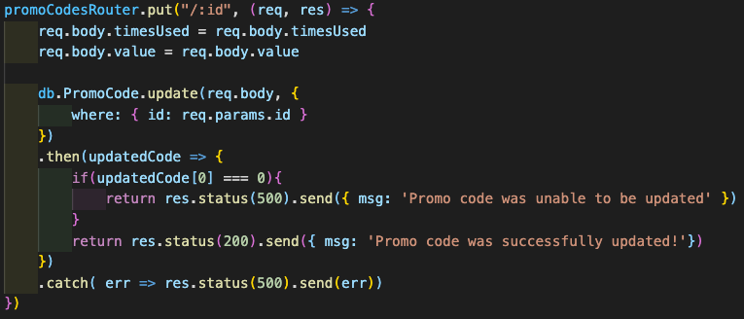
Liskov - Bad Example

Slide 15
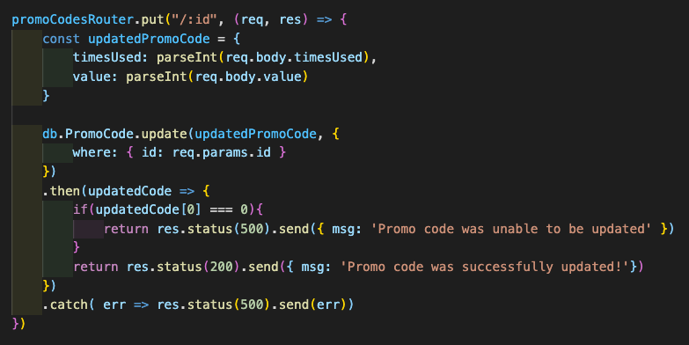
Liskov - Good Example

Slide 16
I = Interface Segregation Principle
Clients should not be forced to depend on an interface they do not use
Functions should use the smallest amount of data they require
Why?
Reduce the side effects and frequency of required changes
Split the software into multiple, independent parts
Ask:
Can I break this into smaller pieces or can I make it work with
less inputs?

Slide 17
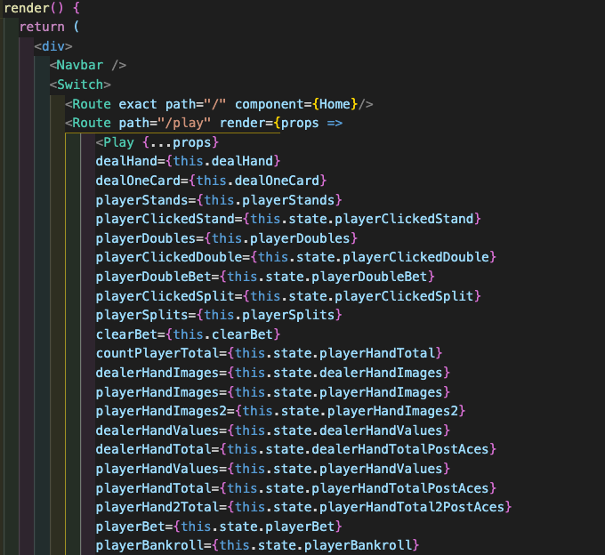
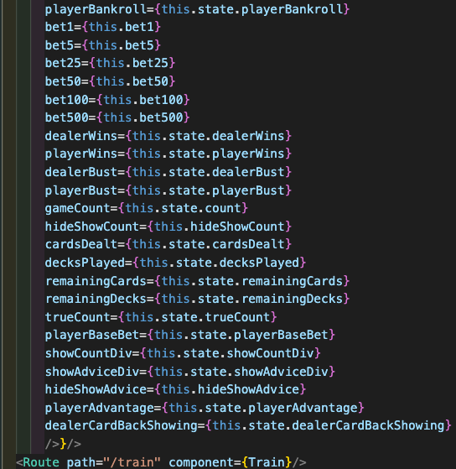
Interface Segregation - Bad Example

Slide 18

Interface Segregation - Good Example

Slide 19
D = Dependency Inversion Principle
Program to an interface, not an implementation
Specify parameters to a function rather than hard coding the function
High-level modules or components, which provide complex logic, should be easily reusable and unaffected by changes in low-level modules
Why?
Promotes reusability of logic
Less work to write new code
Ask:
Can I call this anywhere in my application and have it still work?

Slide 20
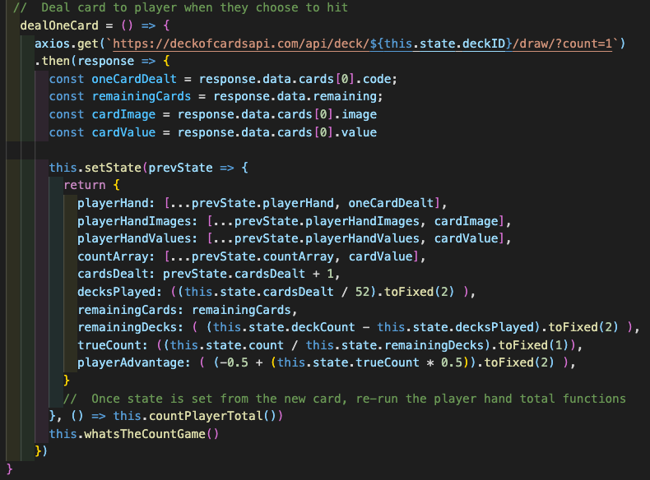
Dependency Inversion - Bad Example

Slide 21
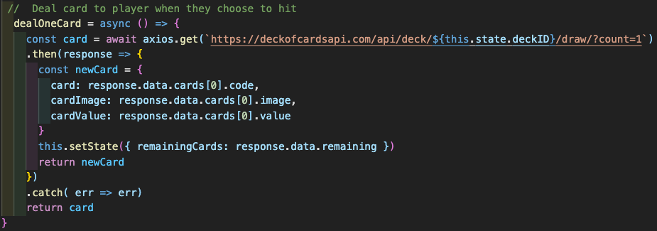
Dependency Inversion - Good Example

Slide 22
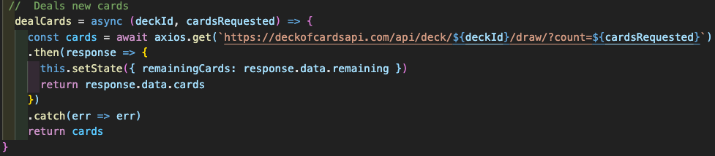
Dependency Inversion – Even Better Example

Slide 23
Takeaways: Is it S.O.L.I.D.?
S = Does this do only one thing and does it do that thing well?
O = Can I make this behave differently and do new things without changing my code?
L = Does this inherit data from somewhere else and will it behave the same way if my data changes?
I = Can I break this into smaller pieces; Can I make it work with less inputs?
D = Can I call this anywhere in my application and have it still work?

Slide 24
Congratulations!
You now have the tools to:
Plan better projects
Debug easily
Reuse and write new code faster
Add new features seamlessly
Be a better programmer than your peers 😎

Slide 25
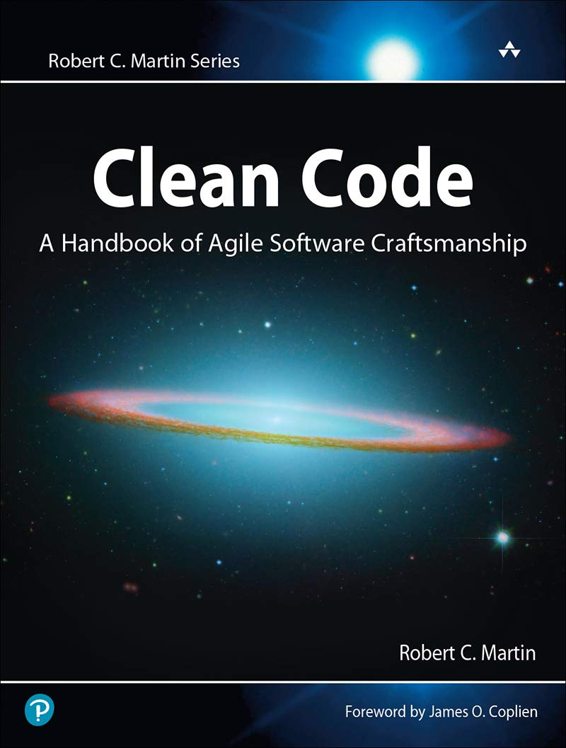
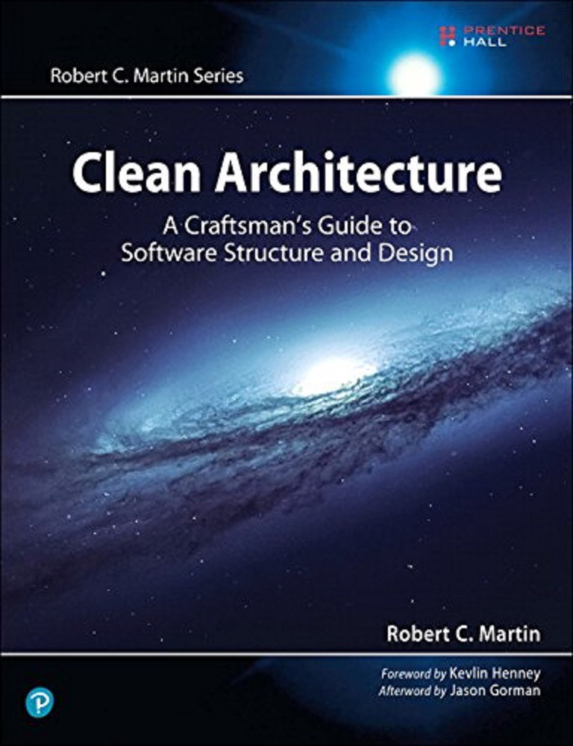
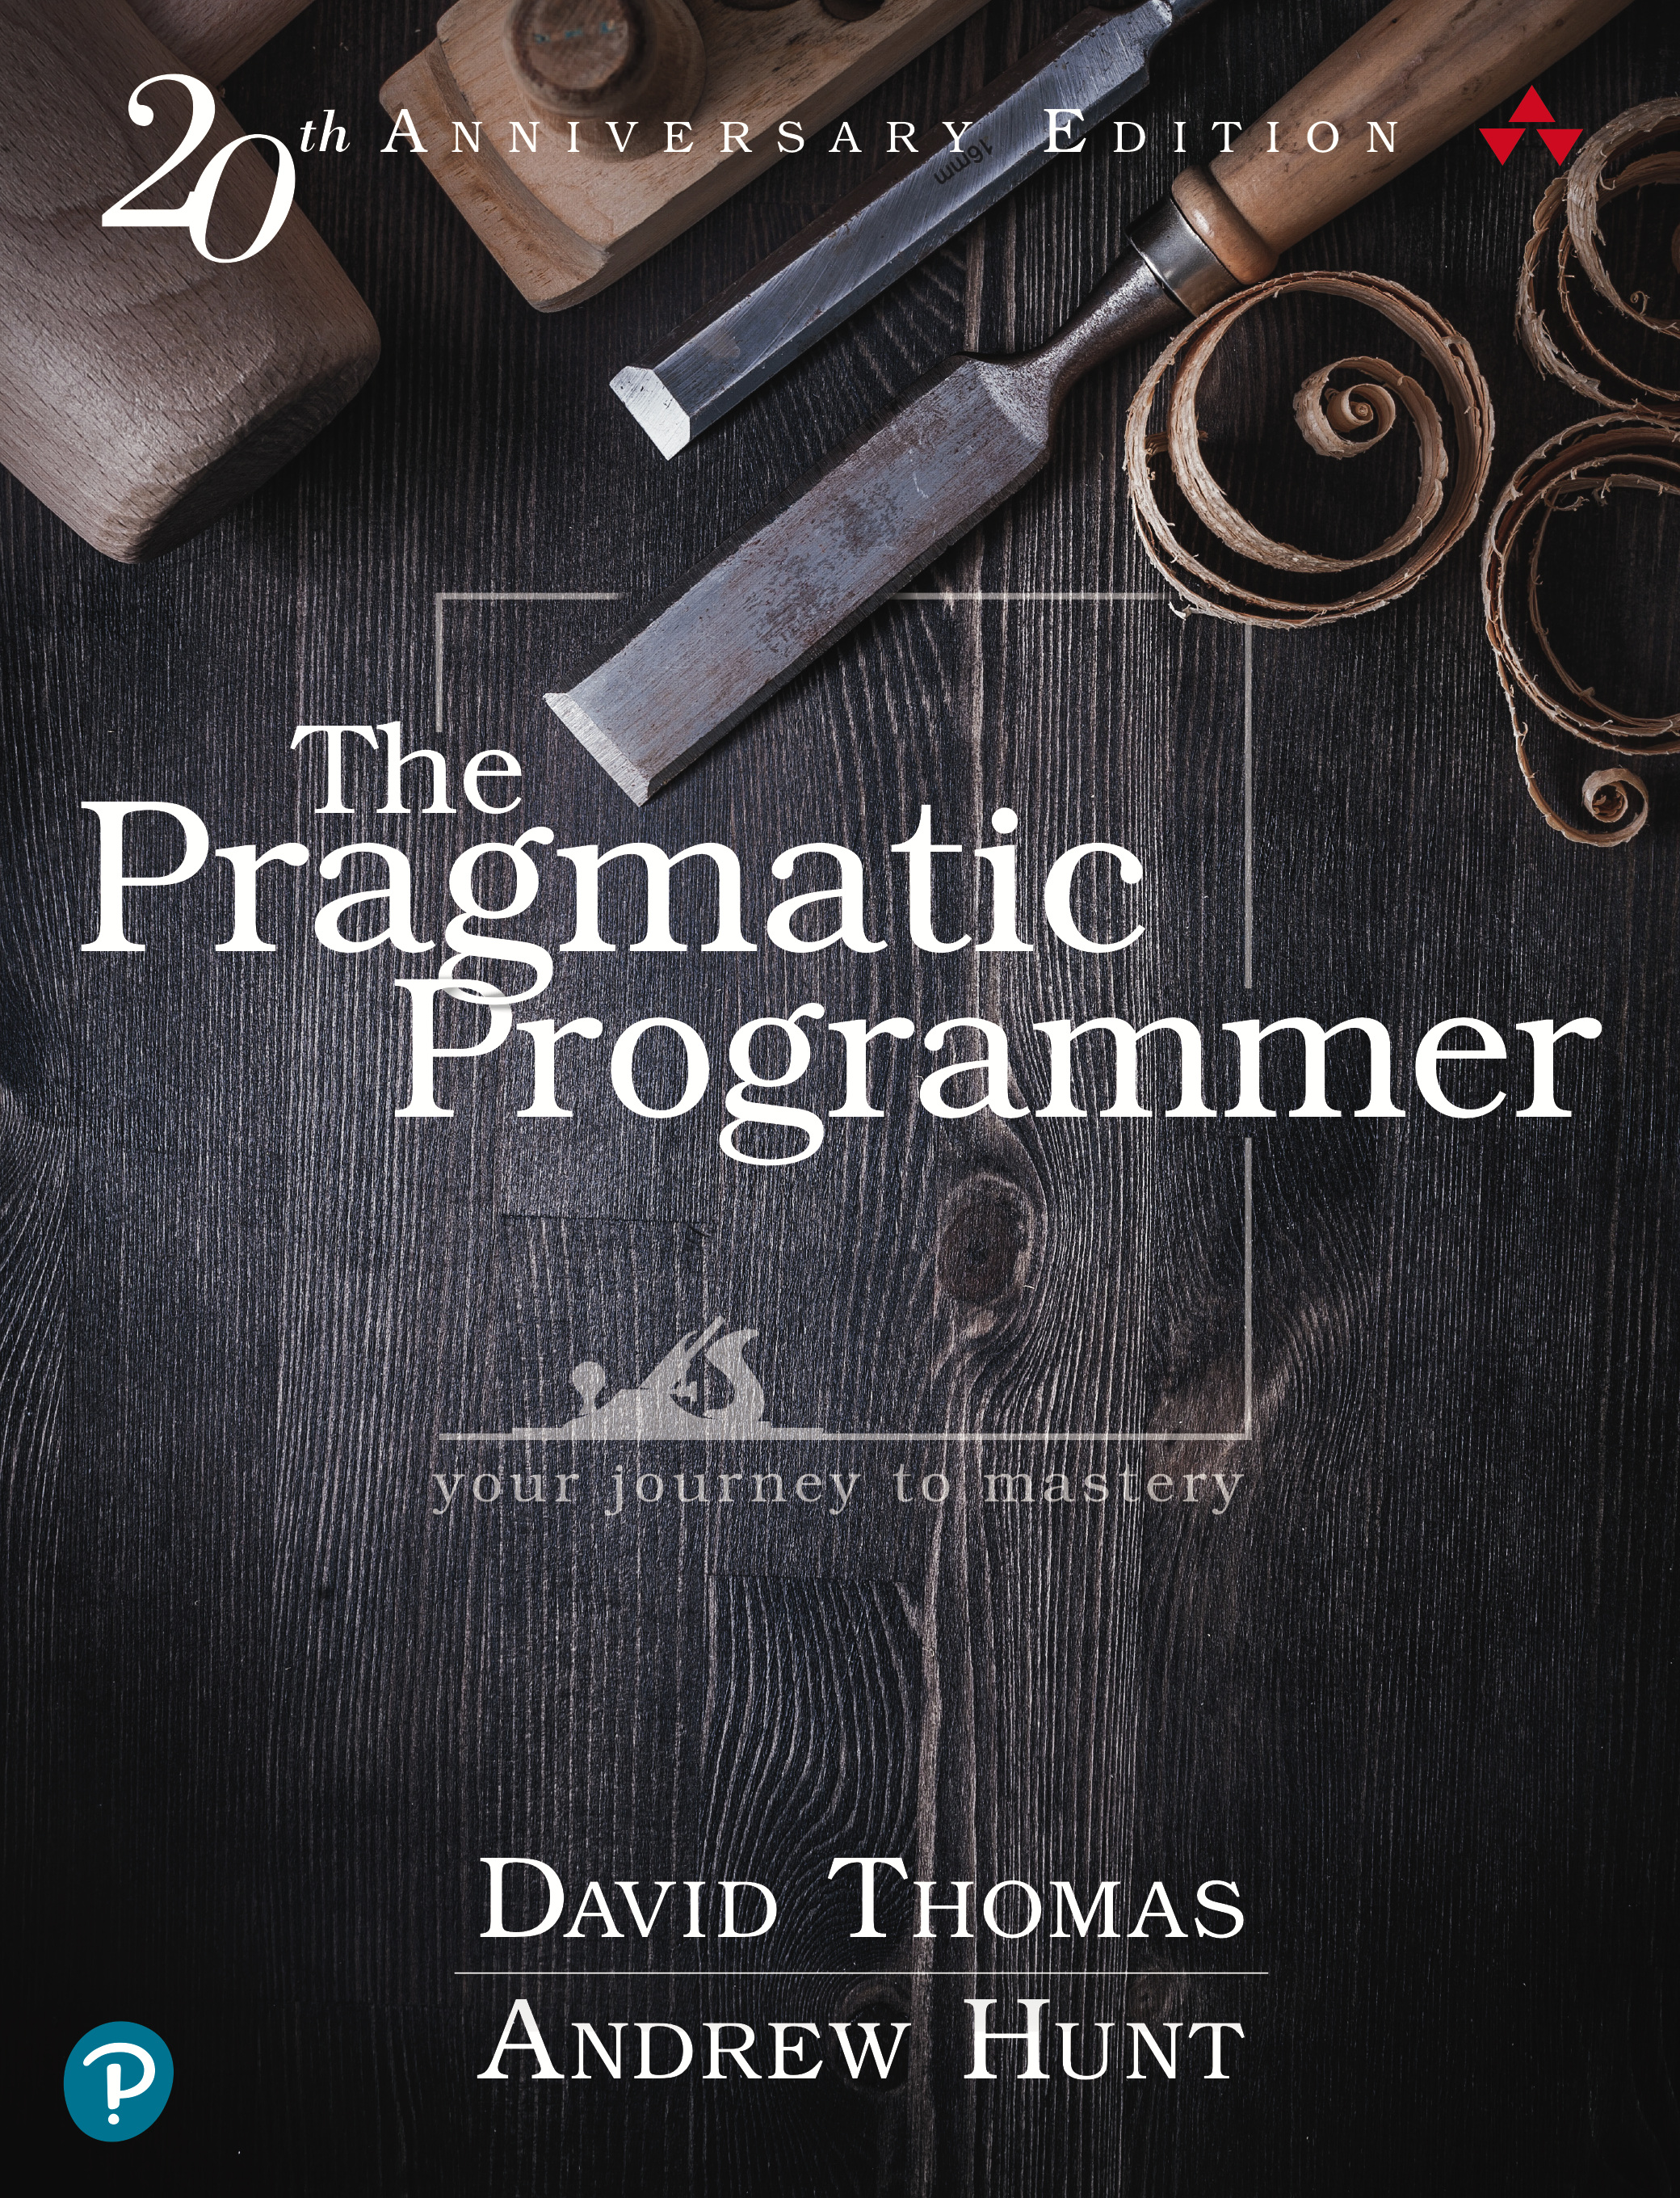
Additional Resources

Slide 26
Let’s Be Friends!
GitHub - @ Eric-Lingren
Slack - @ Eric Lingren
Portfolio – ericlingren.com
Presentation @ https://github.com/Eric-Lingren/resources/tree/main/solid-architecture

